Slide 1
The Team with NO NAME
Henry Dinh, Khanh Phan, Peter Nguyen

Slide 2
Introduction
Topic: Stacked Overflow
Project Description/Outline
First, we will be sorting the data-frame for the most popular types of questions in Python.
Second, we will study the correlation between most upvoted questions and downvoted questions along with their corresponding answers.
Third, we will be comparing the average time it takes to answer the most/least popular tagged questions.
Then, we will be generating a random sample and run a regression analysis for the sample.
Finally, perform a Chi-Square Test on the mean on the sample mean and the population mean in order to test the NULL Hypothesis.

Slide 3
Research Questions
What is the average time it took to answer the questions?
What is the most and least popular libraries?
What is the average score per tag?
What is the correlation between most upvoted questions and downvoted questions along with their corresponding answers?

Slide 4
Hypothesis
Higher Question Scores are associated with higher Answers Scores.
Methodology:
Bar Graphs
Scatter Plots
Simple Regressions
Chi-Square Test

Slide 5
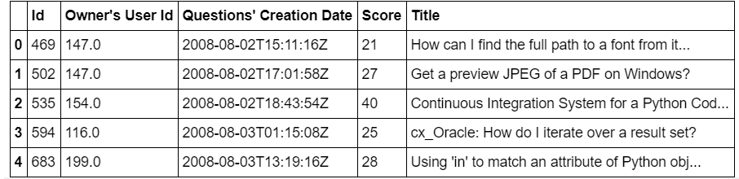
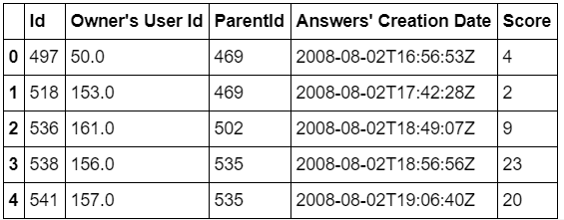
Data

Slide 6
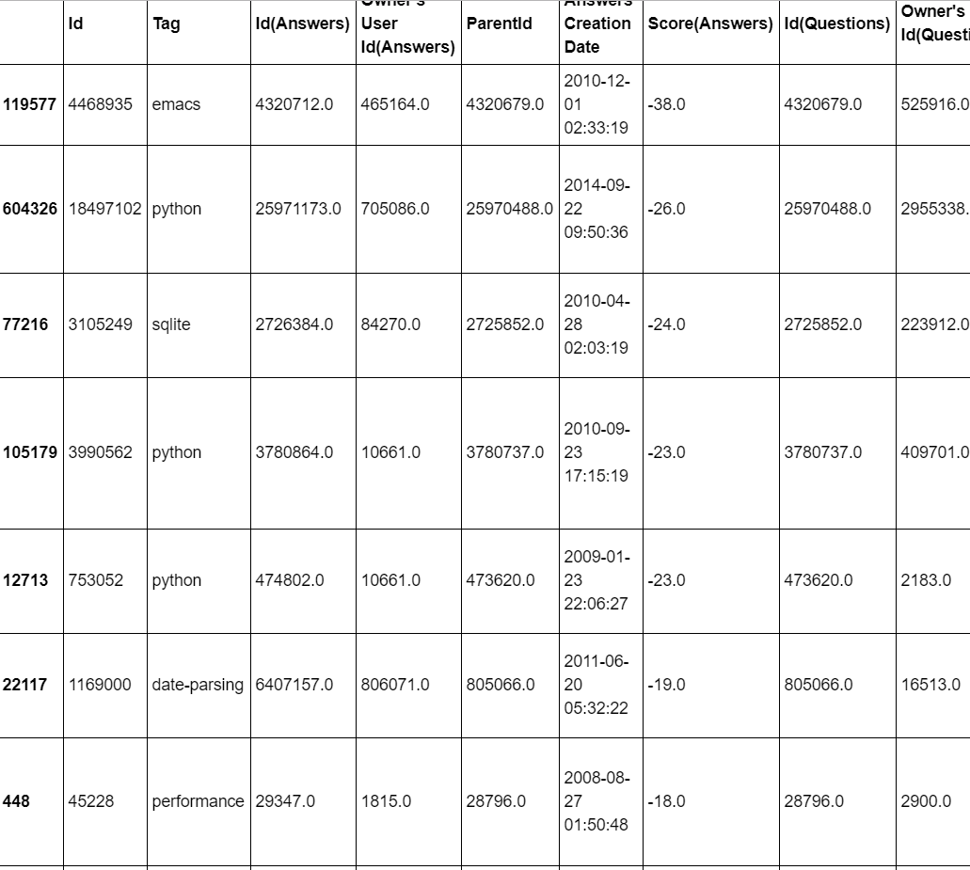
Merge Data

Slide 7
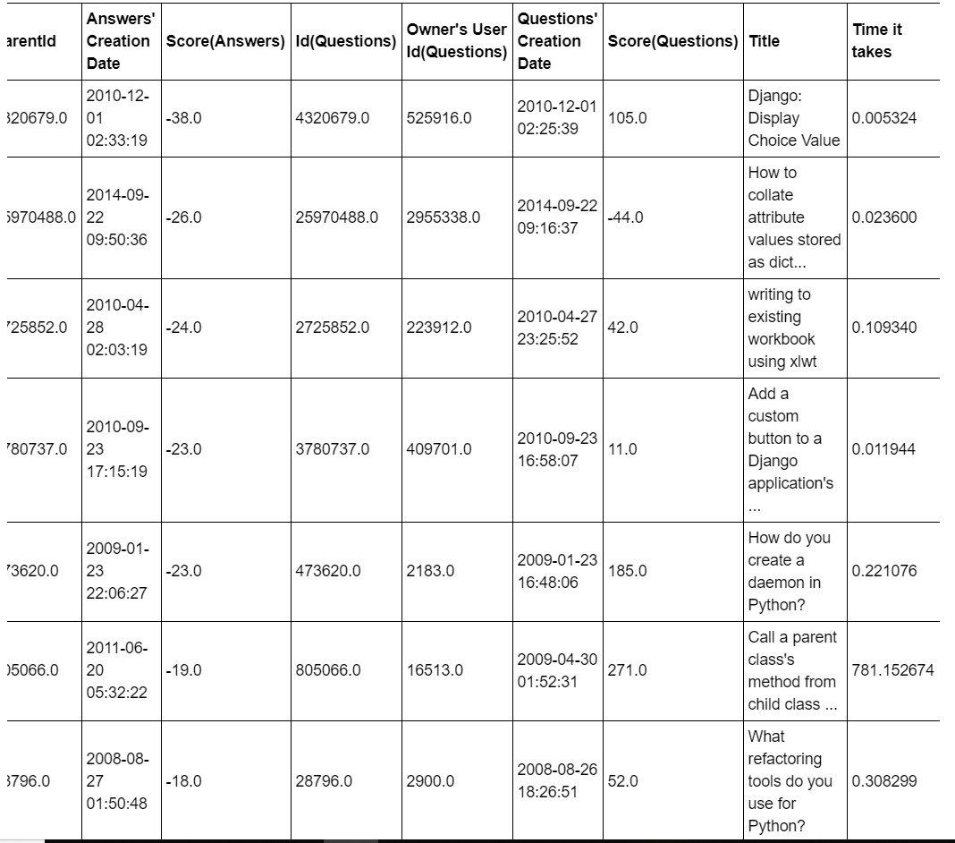
Merge data (Continued)

Slide 8
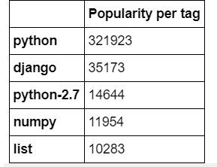
tags

Slide 9
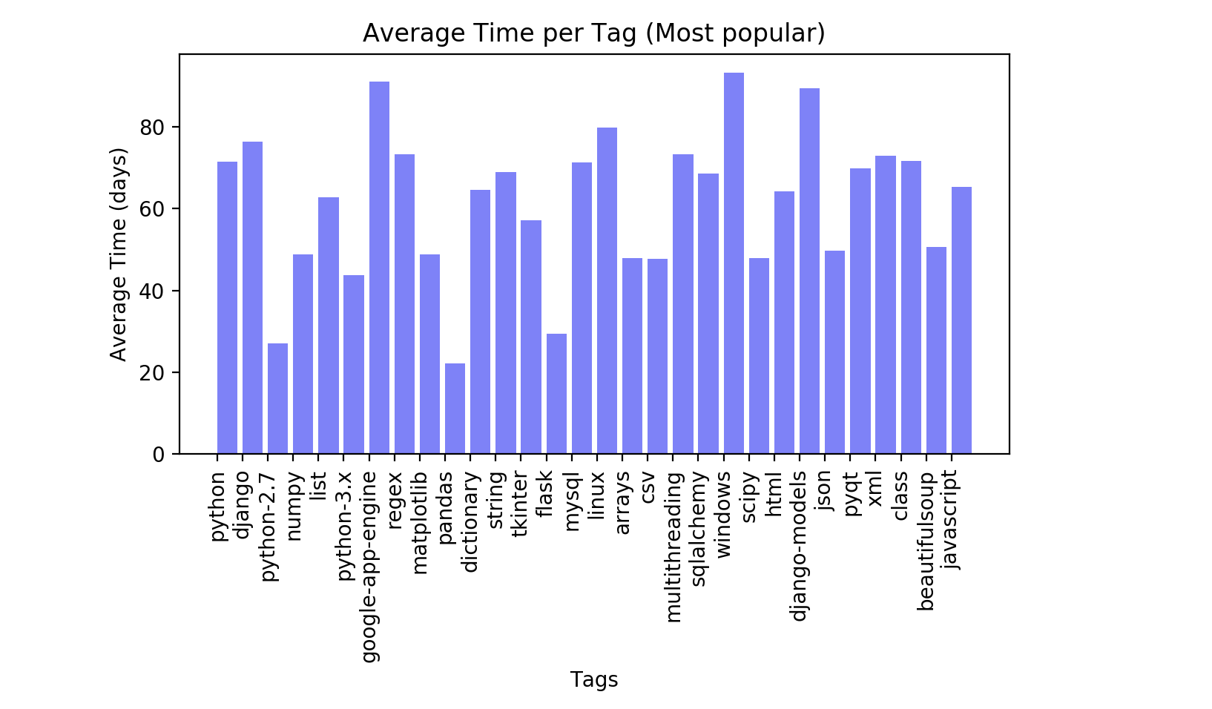
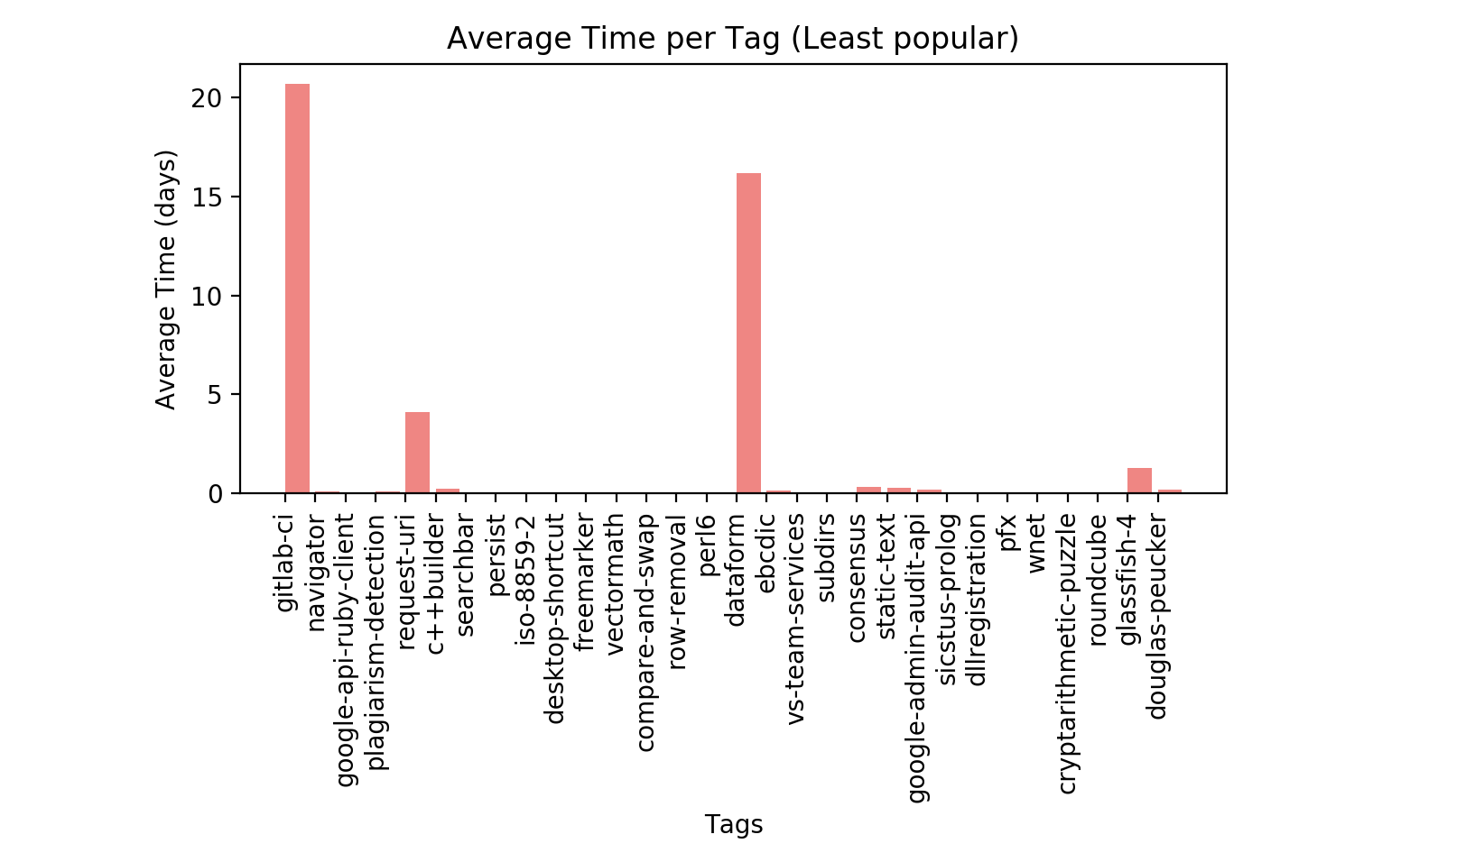
Bar Graphs
This is the average time it took (days) to respond to questions per tag based on 30 most popular tags.
This is the average time it took (days) to respond to questions per tag based on 30 least popular tags.
Question 1 & 2 Answered

Slide 10
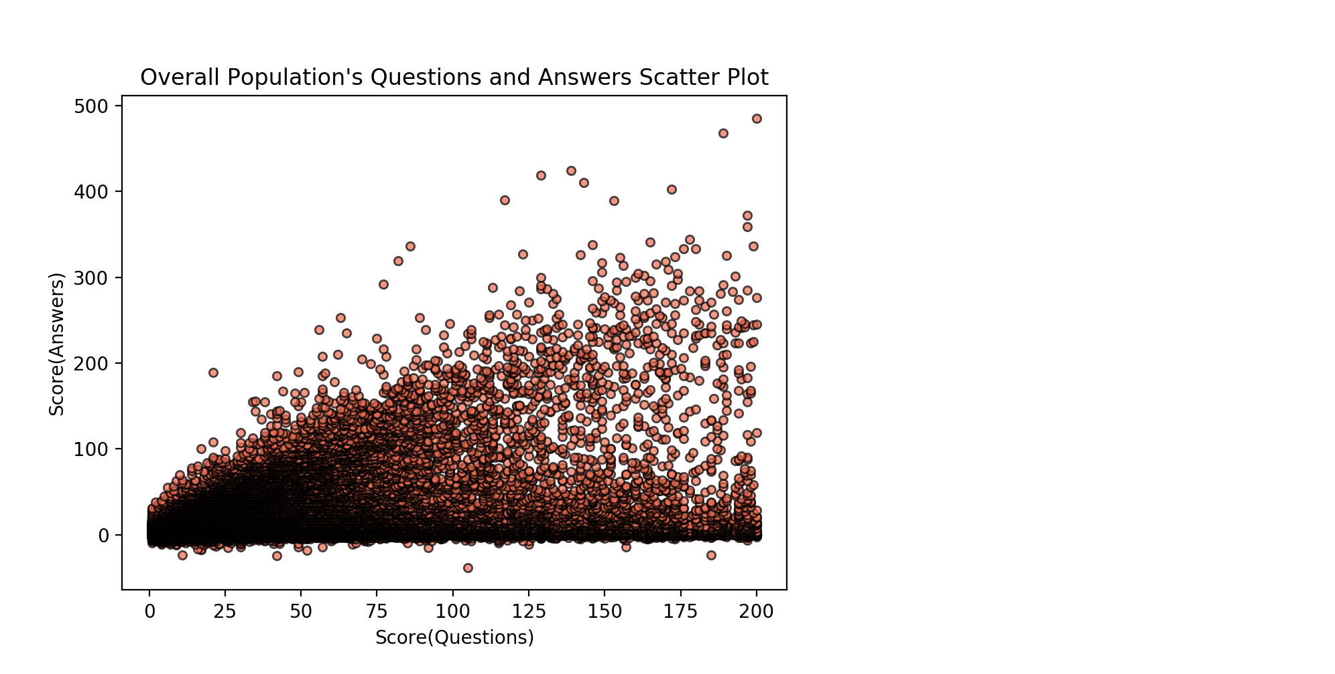
Population Scatter plot
Scatter plot gives us an overview of the correlation between questions' and answers' scores

Slide 11
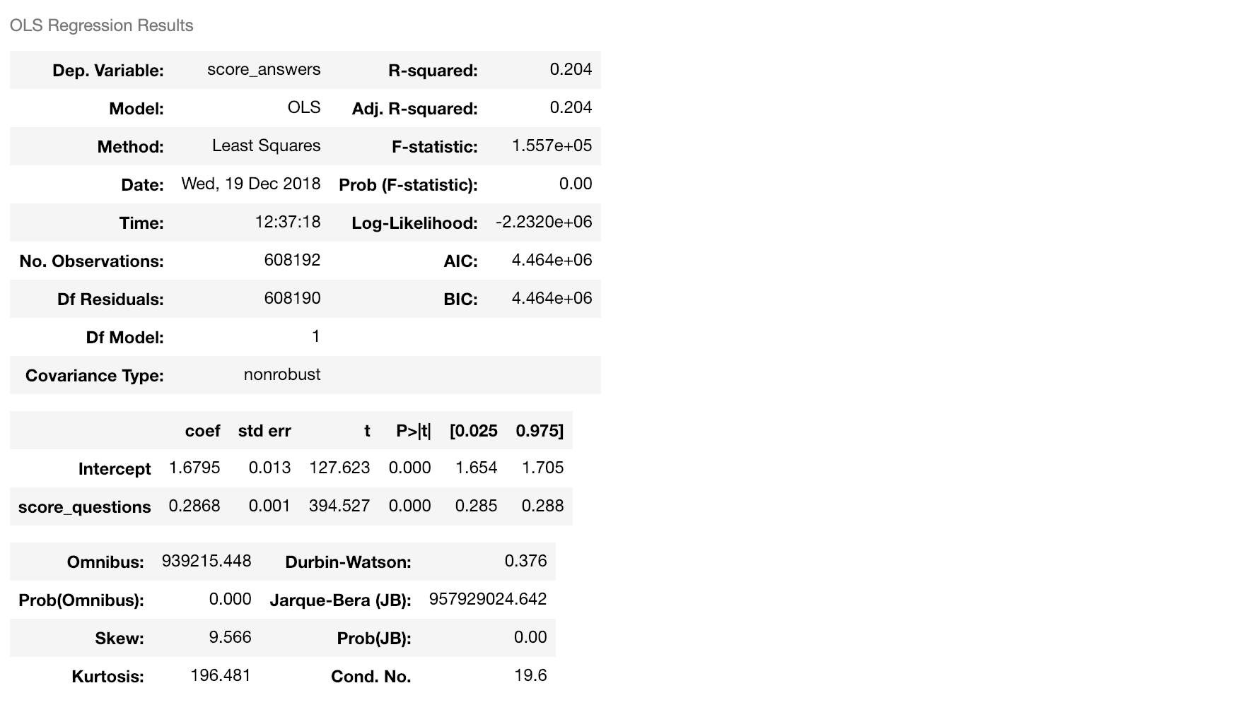
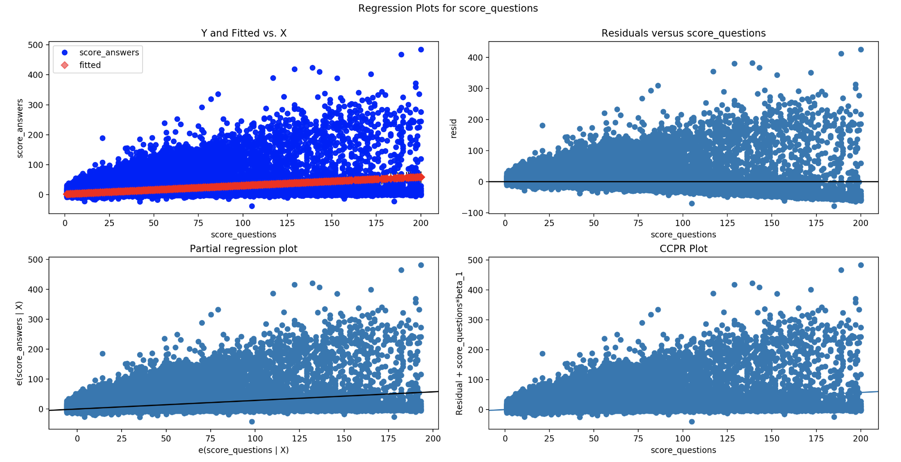
Population Analysis

Slide 12
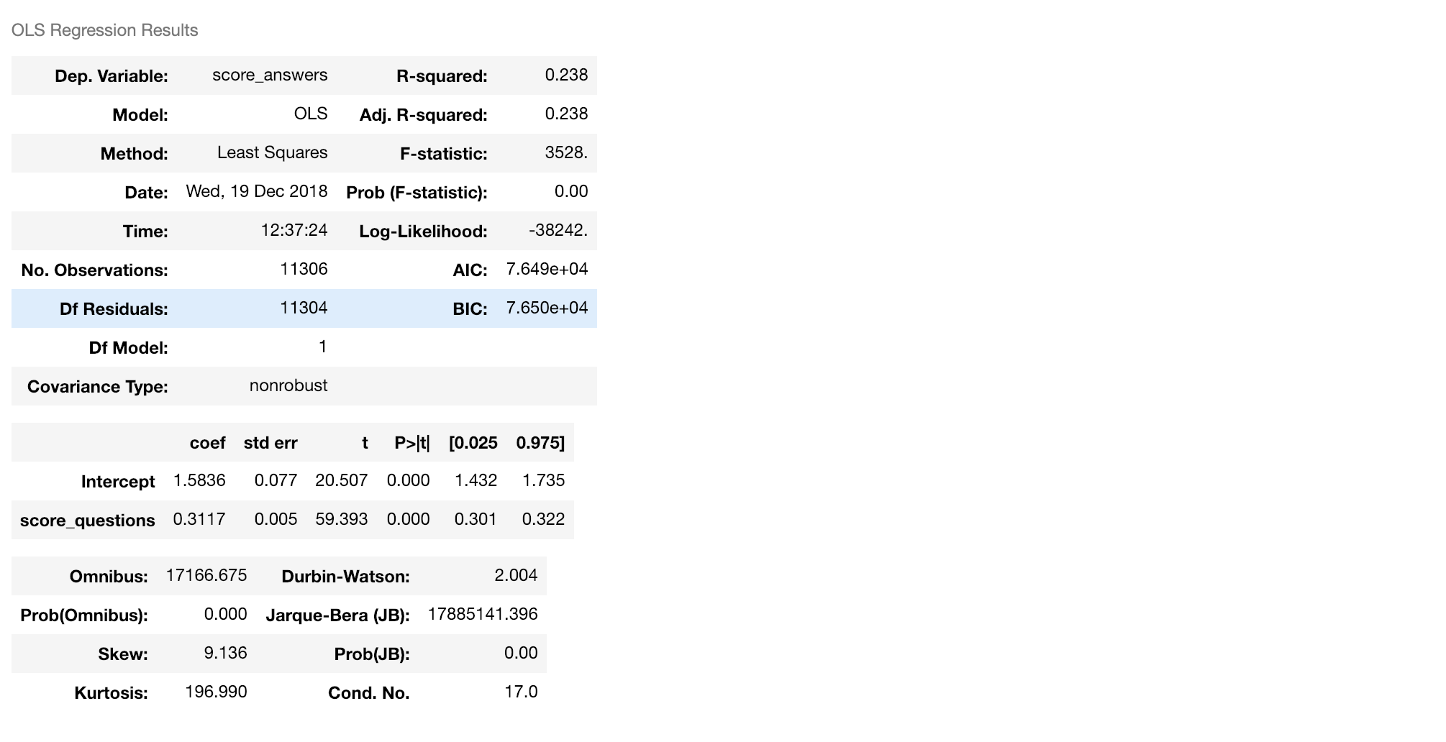
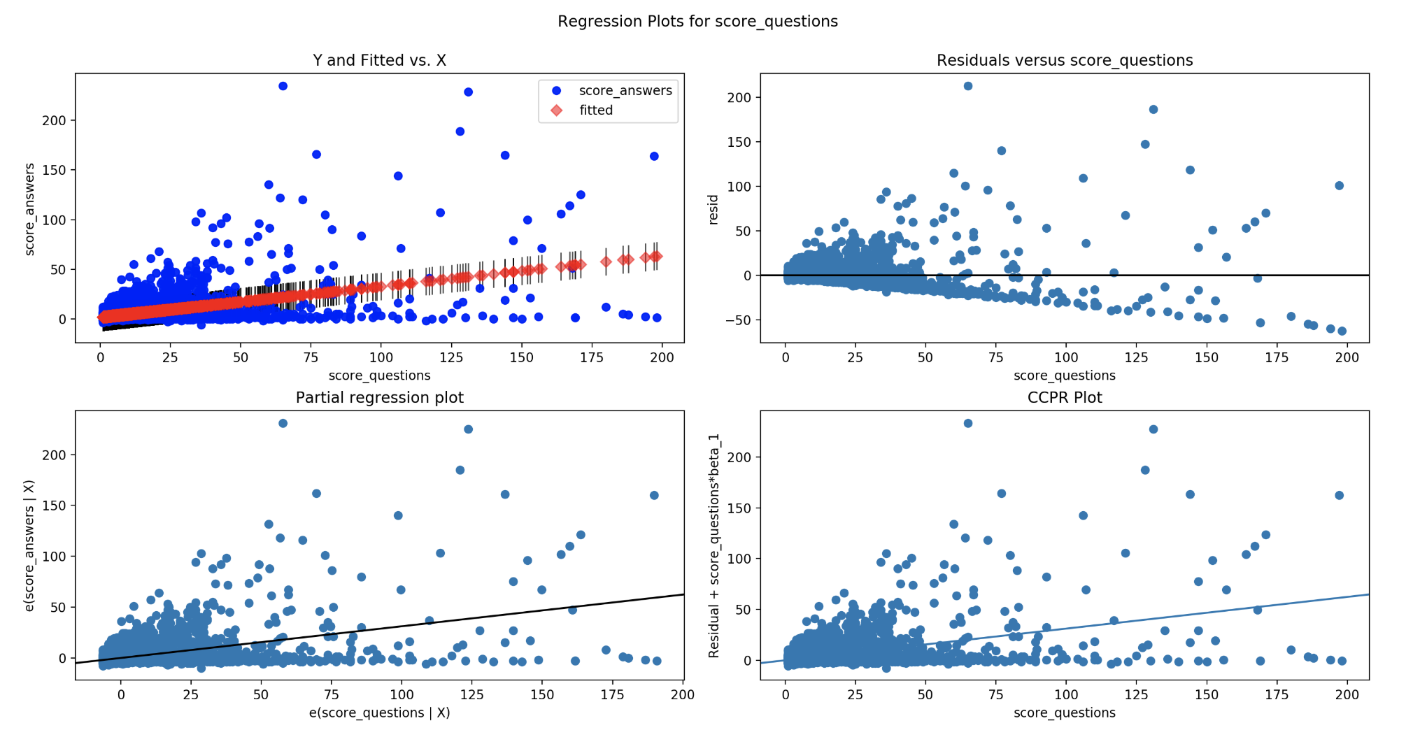
Population Mean Analysis

Slide 13
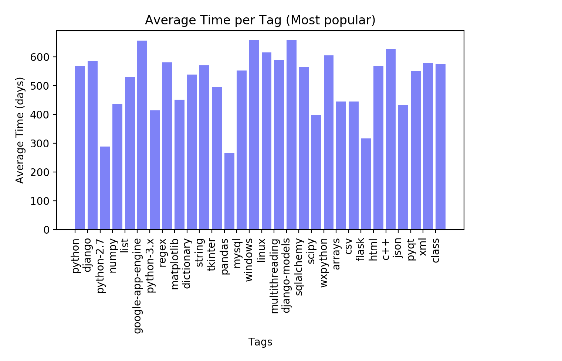
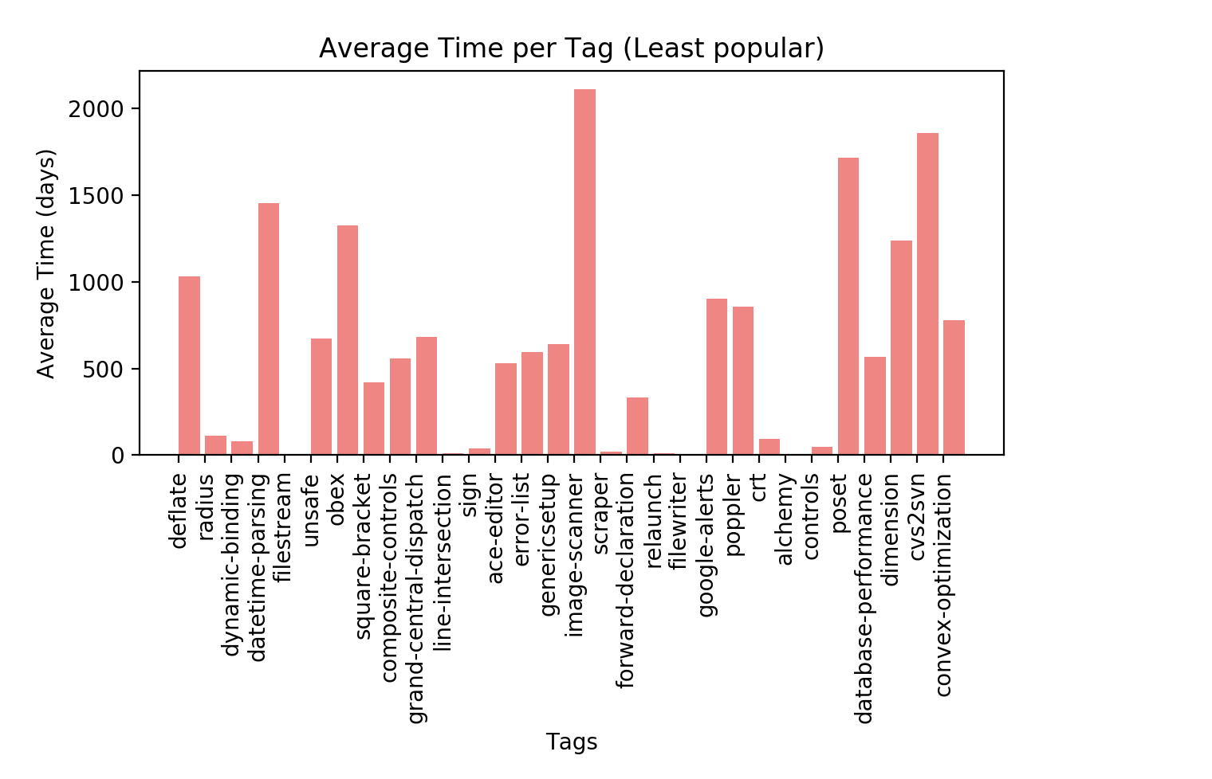
Old Questions Bar Graph
Note: These are the questions that took more than a week to answer

Slide 14
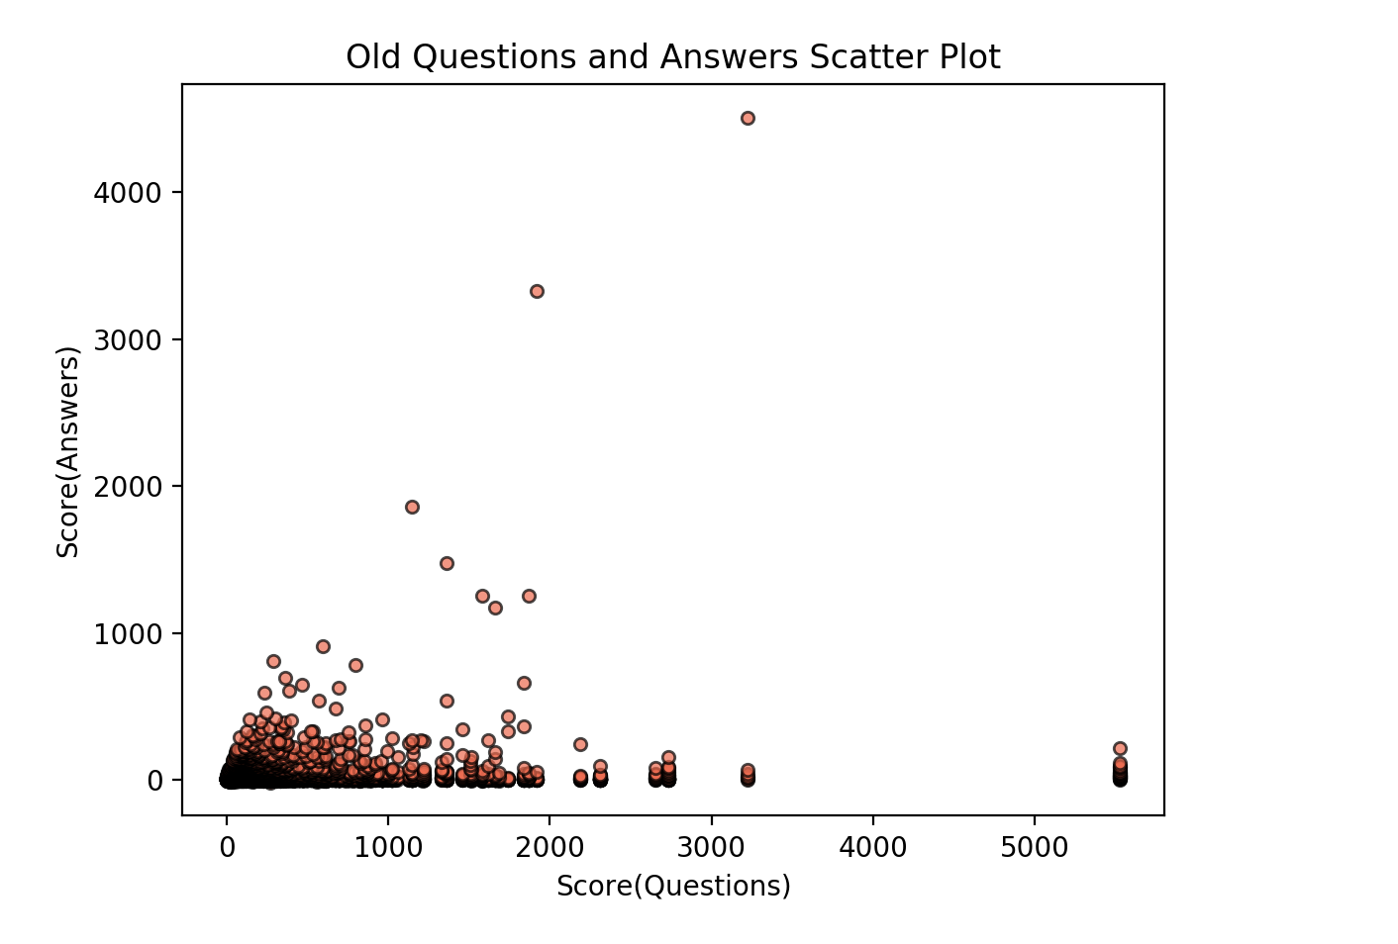
Population Mean Analysis
Pop scatter plot transition to remind classmates

Slide 15
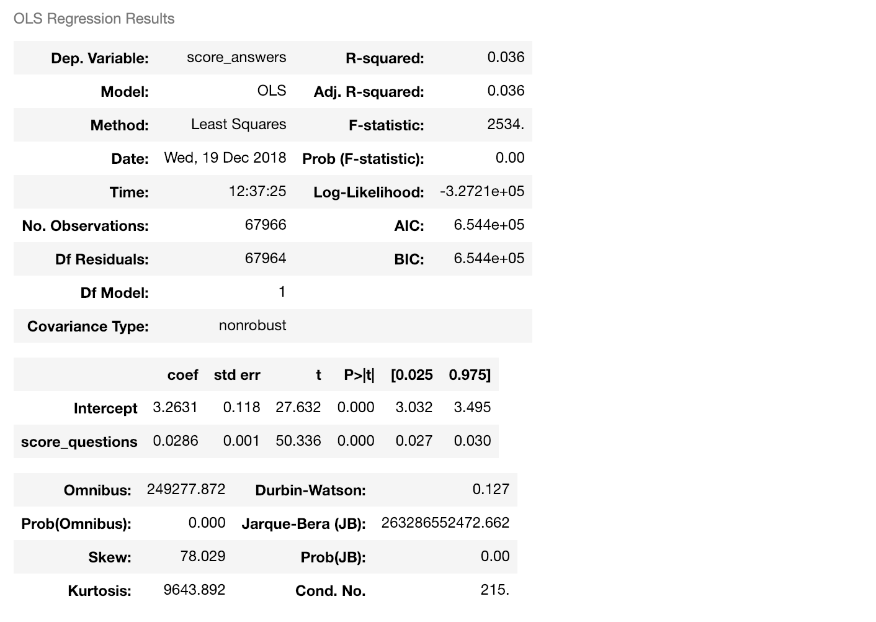
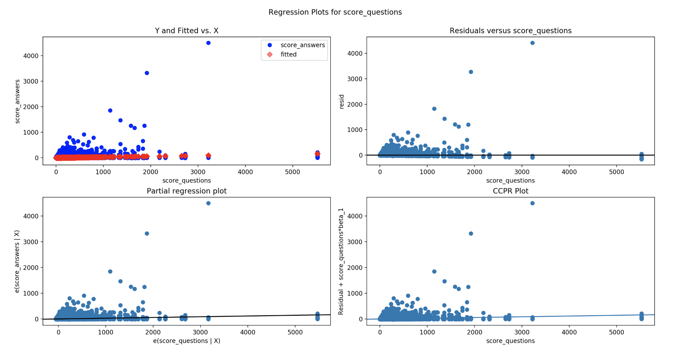
Regression of Old Questions
Temp. Ask Vishal

Slide 16
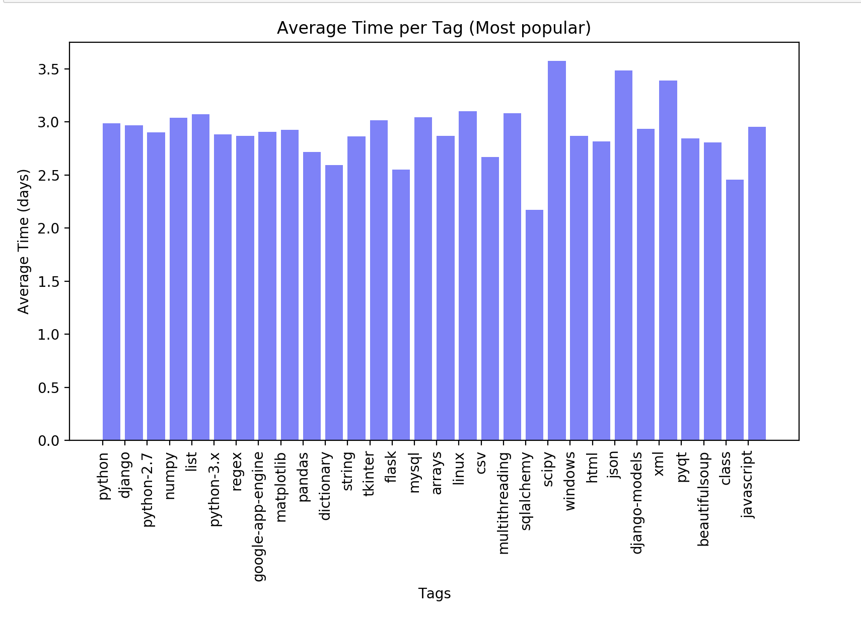
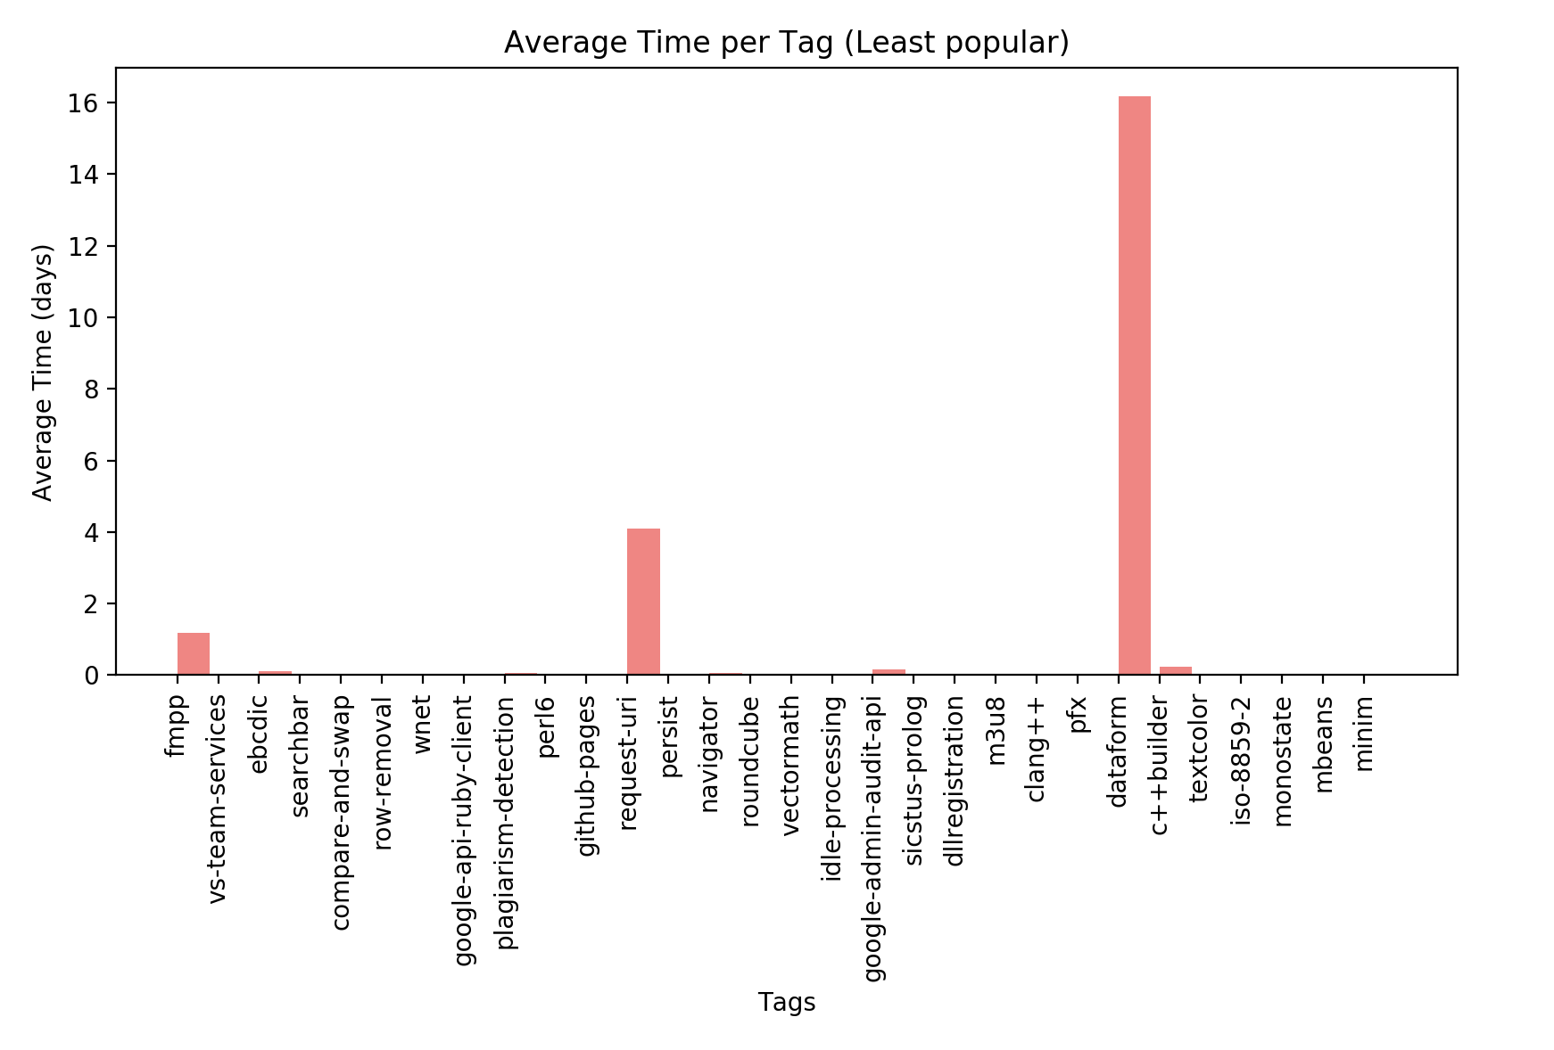
New Questions Bar Graph
We are using the most recently posted questions. Time interval of less than one week

Slide 17
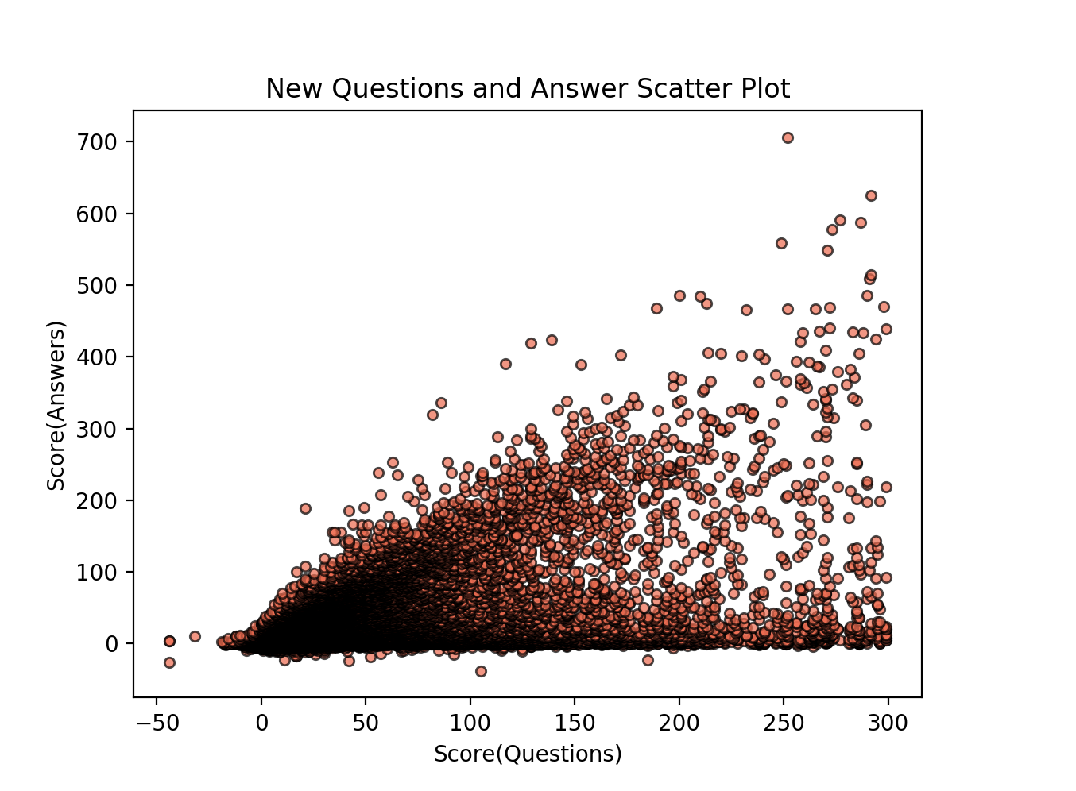
Population Mean Analysis
How to control the density of this graph.

Slide 18
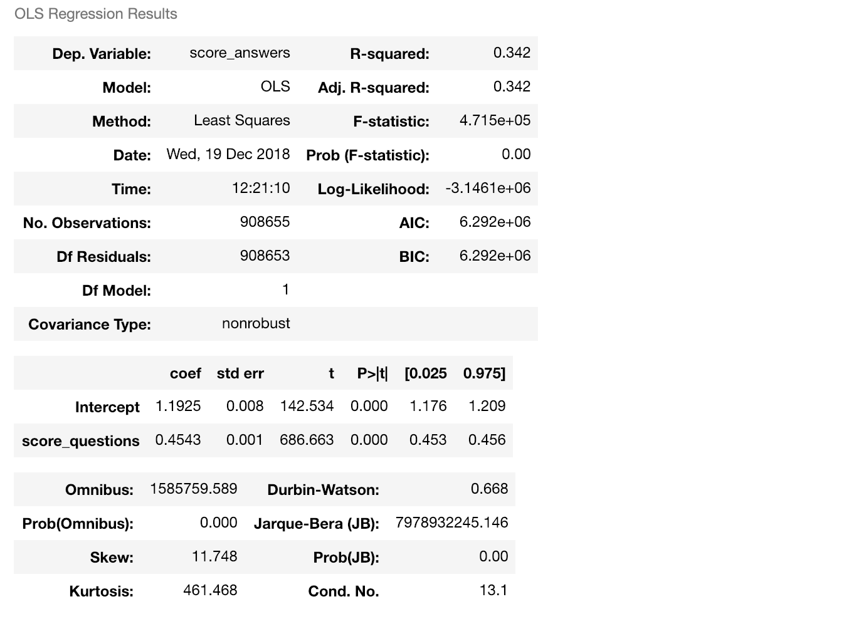
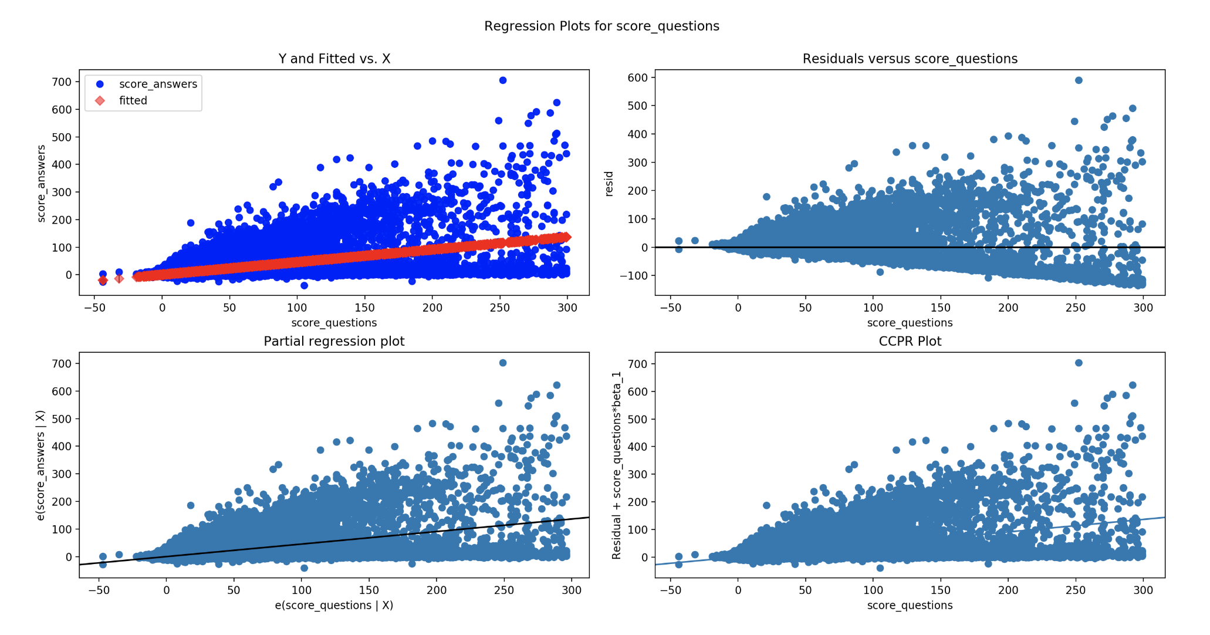
Population Regression (New Qs)

Slide 19
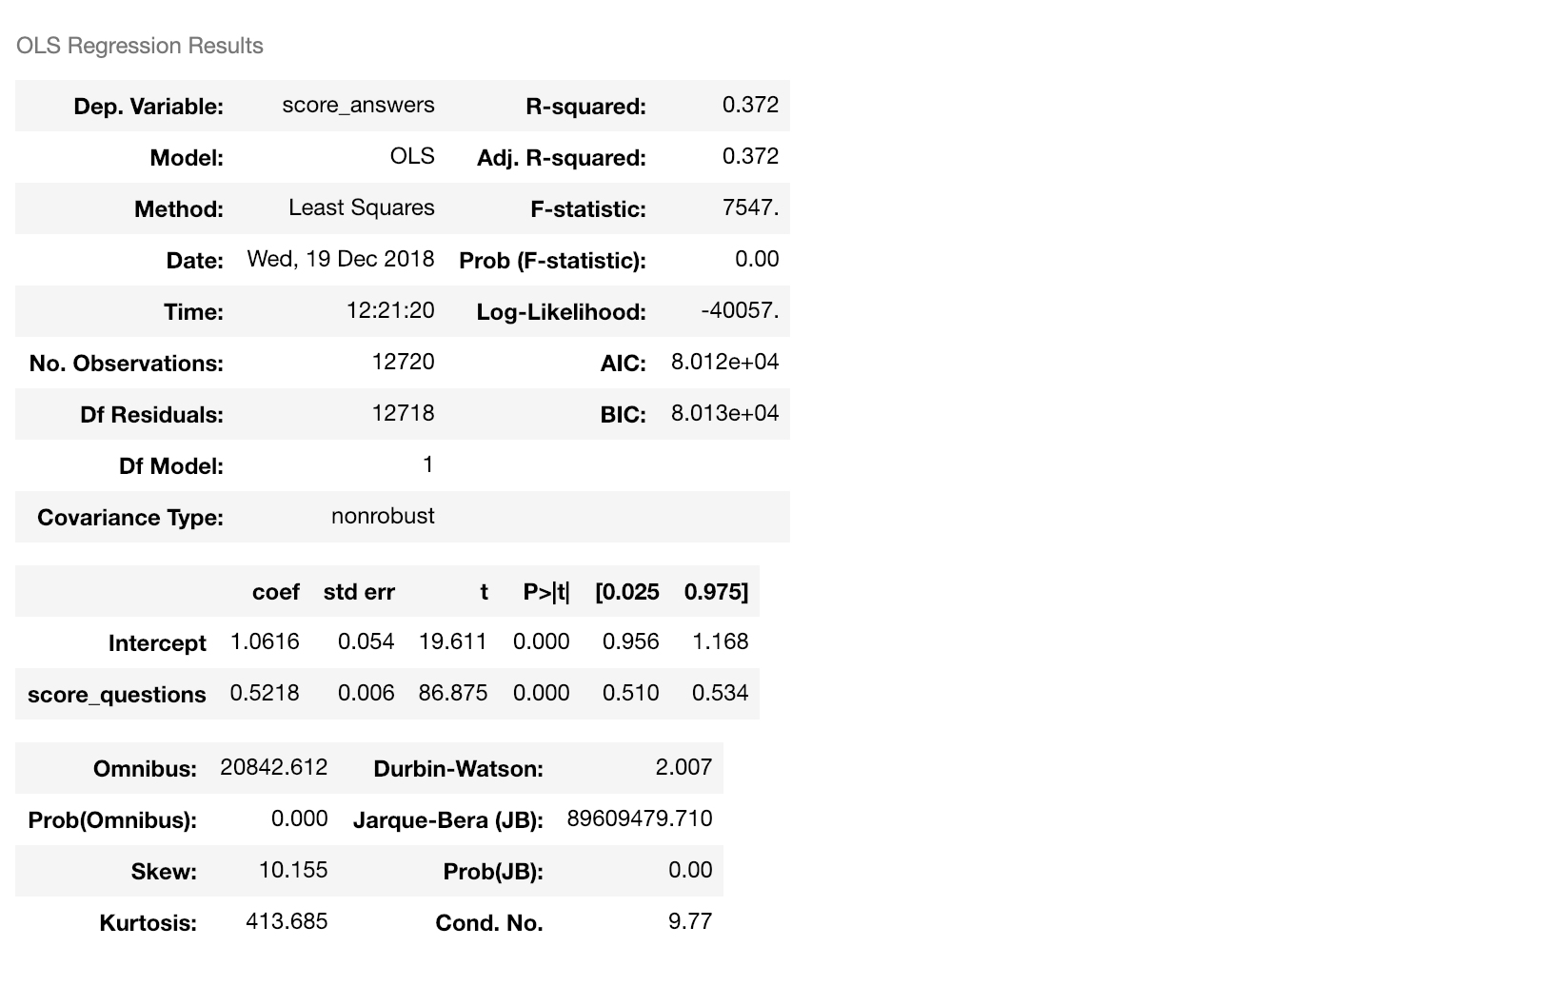
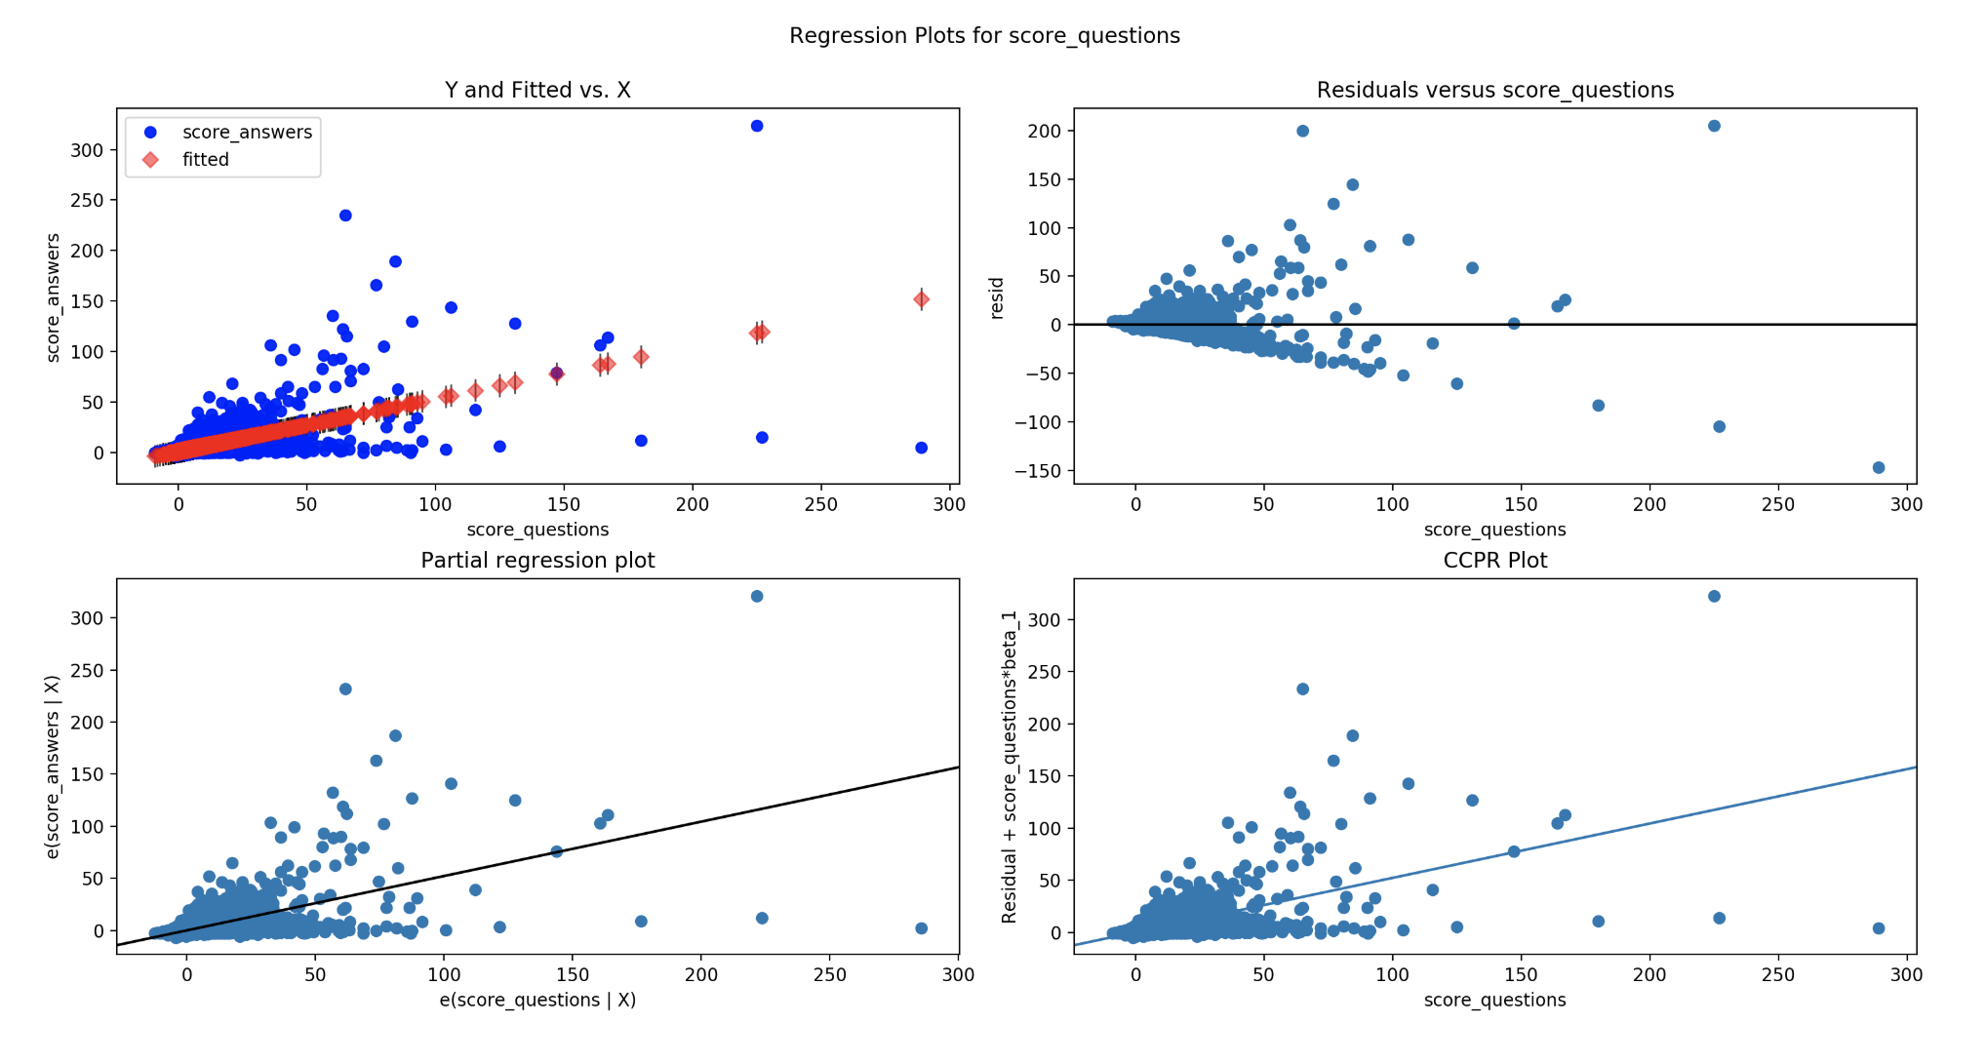
Mean Regression (New Qs)

Slide 20
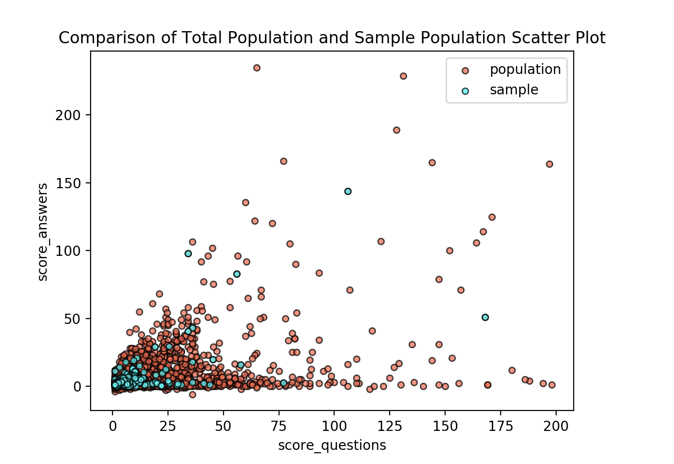
Sample vs Population Scatter Plot

Slide 21
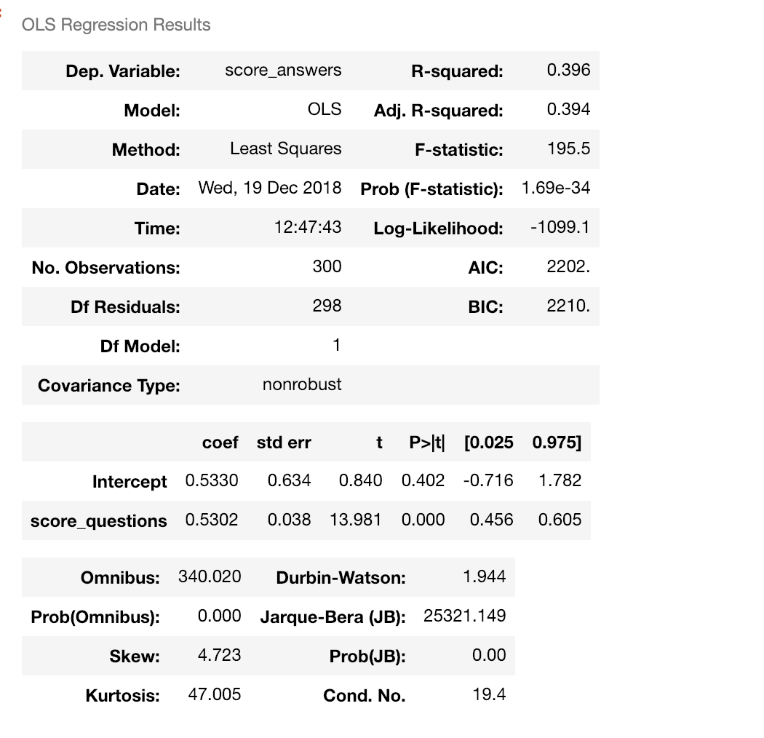
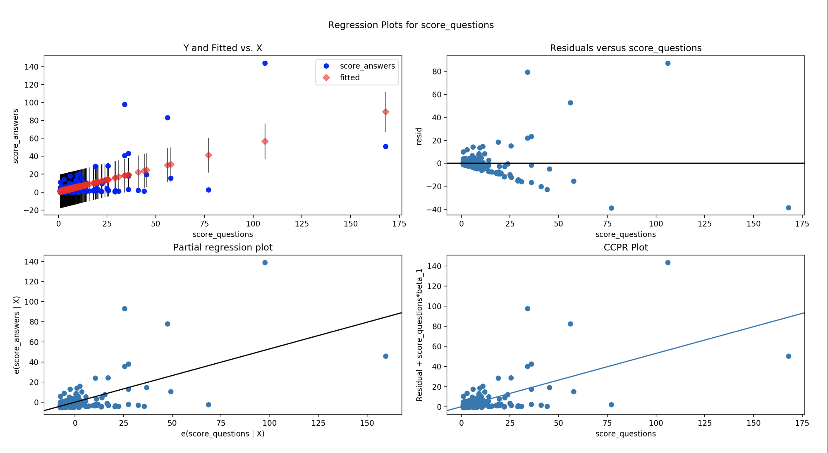
Sample Regression

Slide 22
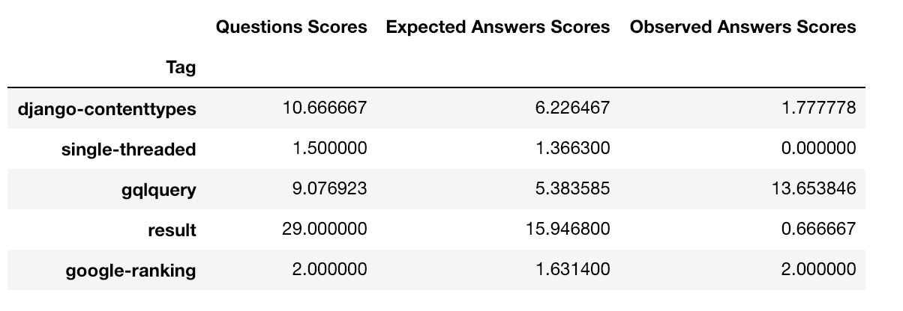
Chi-Square test

Slide 23
Conclusion
Conclusion
Since the chi square value of 1536.84 exceeds the critical value of 330.74, we conclude that the results are statistically significant. Therefore, we can reject the null hypothesis that Questions Scores has no impact on Answers Scores.

